Slide 1
Hapeville Charter Schools
FINANCIAL REPORT (through March 2018)
Board Meeting – April 2018

Slide 2
HCS Financial Summary – as of 3.31.18 – 75% school year
 | January | February | March | April | May | June | Actuals FY 18 | Total Board Approved FY 18
Total Revenue | $ 883,752.18 | $ 900,891.69 | $ 876,547.40 | $ 967,688.24 | $ 967,287.64 | $ 944,961.29 | $ 7,852,841.93 | $ 11,001,864.19
Total Expenses | $ 801,776.55 | $ 903,903.56 | $ 937,544.73 | $ 882,178.68 | $ 866,482.55 | $ 830,360.09 | $ 7,562,688.14 | $ 10,649,364.00
Total Fixed Assets & Long Term Liabilities | $ 29,448.32 | $ 26,003.36 | $ 26,003.36 | $ 31,583.33 | $ 35,083.33 | $ 24,583.37 | $ 291,125.06 | $ 352,500.00
 | Actuals | Actuals | Actuals
 |  |  |  |  |  | Total Expenses | $ 7,853,813.20
(OVER)/Under | $ 52,527.31 | $ (29,015.23) | $ (87,000.69) |  |  | Expense/Budget | 71%
Cumulative (OVER)/Under | $ 115,044.65 | $ 86,029.42 | $ (971.27) |  |  | Expense/Total Exp | 71%
KEY POINTS:
Cumulatively, we are $971 in the RED in comparing actual revenue to actual expenses YTD
Focus needs to be on paring expenses (highlighted) and recovering unrealized revenue.

Slide 3
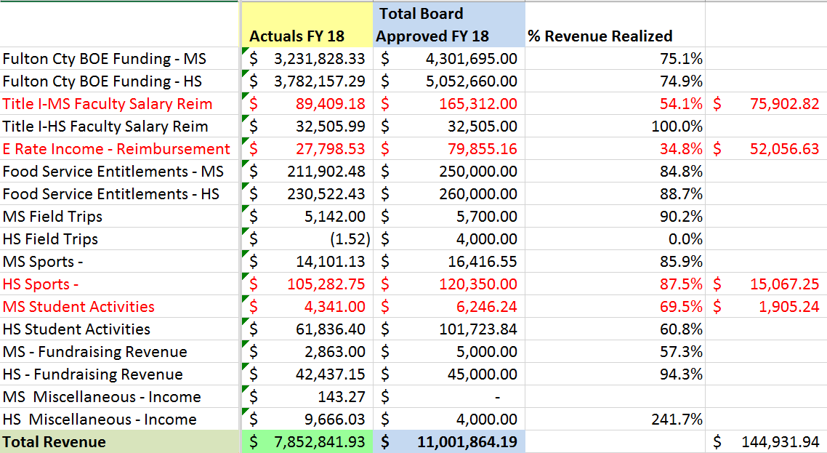
HCS Financial Summary – as of 3.30 – 75 % school year
Need to focus on recovering these revenue items and pare back expenses – to be reviewed
with Mr. Lindsay and Ms. Olsen

Slide 4
Food Service: summary

Slide 5
HCS 2018-19 Next Steps…time to start planning the budget for 2018-19
Preparation of budget calendar
As always, development of budget is driven from requirement to approve preliminary budget at June Foundation Board meeting
DONE – 3/22 - By March BOD meeting, plan to have first Finance Committee meeting to identify key milestones for budget development
ED is developing and CFO setting dates needed
Faculty/staff needs
Instructional needs
Administrative needs
First Draft – 2018-19 Budget is in review
Key dates
DONE - March 22 – first meeting with FCSS for 2018-19 budget review
May 2018 BOD – Budget Hearing #1 (projected)
June 2018 – Foundation Board to set date for annual meeting to review and approve preliminary budget

