Slide 1
State of the School
March 26, 2018

Slide 2
Our Mission

Slide 3
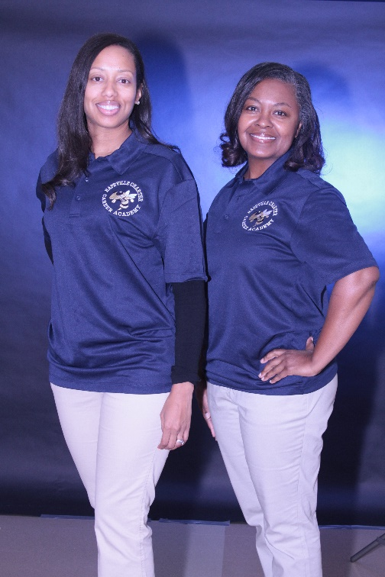
Who are we?
Principal Candace Bethea
Assistant Principals Winston Gordon
Stacy Henry
Dr. Vonterrisa McKinney
Director of Dual Enrollment, WBL, and CP Tracy McClure
Counselors Sabrina Barnes
Aranya Knox
Registrar & Data Clerk Stefanie Orgertrice
Instructional Support Teacher Staci Abercrombie
Office Manager Trina French
Athletic Director Keydrick Barlow

Slide 4
What is Hapeville Charter Career Academy?
9-12 charter school servicing students in Fulton County Schools
Career Academy focusing on a Dual Enrollment Partnership with Atlanta Technical College
Dual Enrollment Opportunities with Georgia Military College and other area colleges and universities
Smaller school that exceeds academic challenges
Title I school
Free breakfast and lunch daily catered by Chef Advantage
Applications are required

Slide 5
2017 – 2018 School Improvement Goals
Increase student achievement in core content areas as measured by the Georgia Milestones End of Course
Increase opportunities for academic acceleration outside of Dual Enrollment

Slide 6
GA Milestones Results from 16/17
Growth in all areas except for Science
Exceeded GADOE targets in ELA
Did not exceed GADOE targets in Math, Science, and Social Studies

Slide 7
Georgia Department of Education
Completed First Status Review on December 14, 2017
1st Priority Monitoring Tutorials
2nd Priority Instructional Observations
Focus on PLCS
Assessment Calendar through PLCS
Isolate good instructional practices
Second Status Review on Tuesday, April 11 at 9:00 am
2nd Short Term Action Plan
Extended Day and Saturday School
Classroom Walkthroughs/Observation Schedule
Align formative assessment questions to learning targets
Use Fastbridge Data
Assign students to Extended Learning
Assessment calendars

Slide 8
Achieving our 17-18 Goals
Professional Learning Communities (PLCs)
Lesson Plans
Assessment Calendar
Professional Learning geared toward goals
Classroom Observations
Extended Learning and Saturday School Tutorial to include FEV tutor
Advanced Placement Training for Teachers
Parent Conference Evenings
Frequent Parent Communication
Princeton Review classes for SAT and ACT
EOC Tuesday and Wednesday

Slide 9
Developing Instructional Leaders for Academics
Leadership Team Meetings
Instructional Decision Making Body
Review data
Monitor Progress
Design processes and protocols to ensure capacity building
Professional Learning Communities
Plan effective lessons
Share evidenced based instructional strategies
Model the appropriate delivery of instruction
Analyze data
Provide Professional Learning
Create and develop assessment items

Slide 10
Professional Learning
Depth of Knowledge
Book Studies focusing on Culture
Learning Targets
Lesson Plans
Technology
Analyzing Data (ATLAS Protocol)
Gradual Release

Slide 11
Assessment
Assessment Calendar by Departments
Fast bridge
Write Score
Common Assessments where applicable
EOC preparation and EOC mock examinations

Slide 12
Technology Resources for Students and Teachers
FEV Tutor
Study Island
Moby Max
USA Test Prep
All In Learning
Turn It In
IXL

Slide 13
Title I 17/18 School Improvement Funds - $83,000
FEV Tutors
Professional Learning for Social Studies
Test Prep Books for Advanced Placement Classes
2 carts of Chromebooks
Registration Fees for Advanced Placement training for 20 teachers
Instructional Materials and Supplies
Registration fees for 3 math teachers to attend the Math Summer Institute

Slide 14
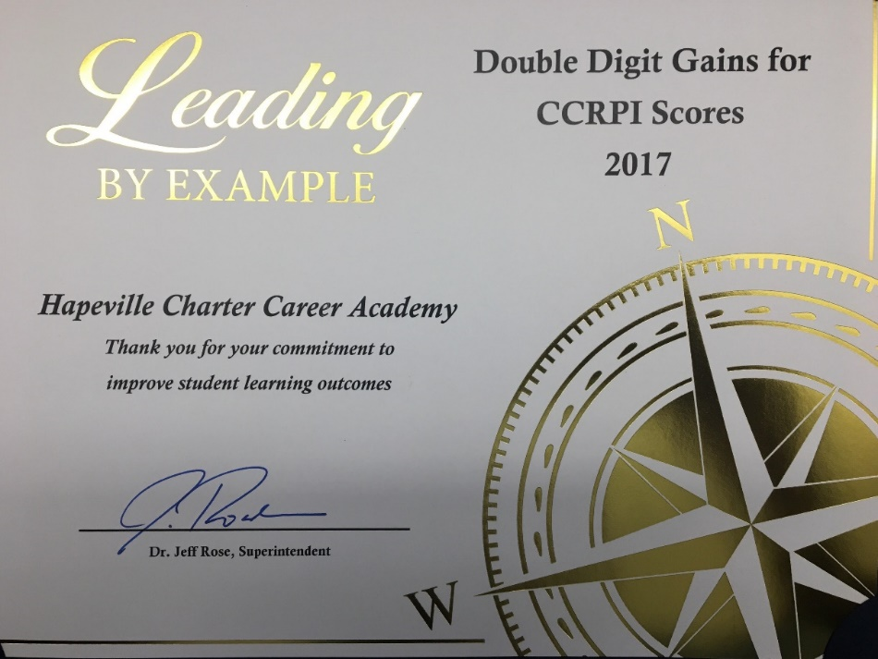
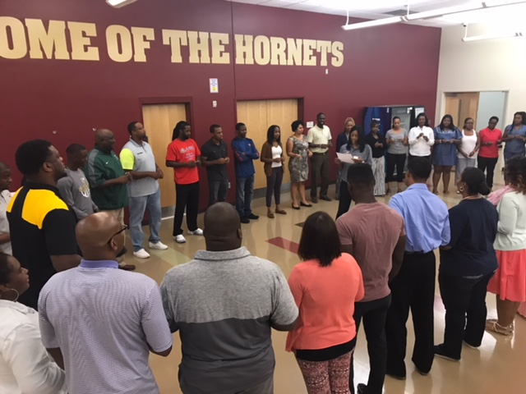
Academics
A/B Block Schedule
4 courses daily
110 minutes of instructional time
Class sizes range from 15 – 35
English Language Arts
Entrepreneurship Pathway
Math
Physical Education and Health
Science
Social Studies
Spanish
ACT Prep
SAT Prep
Dual Enrollment

Slide 15
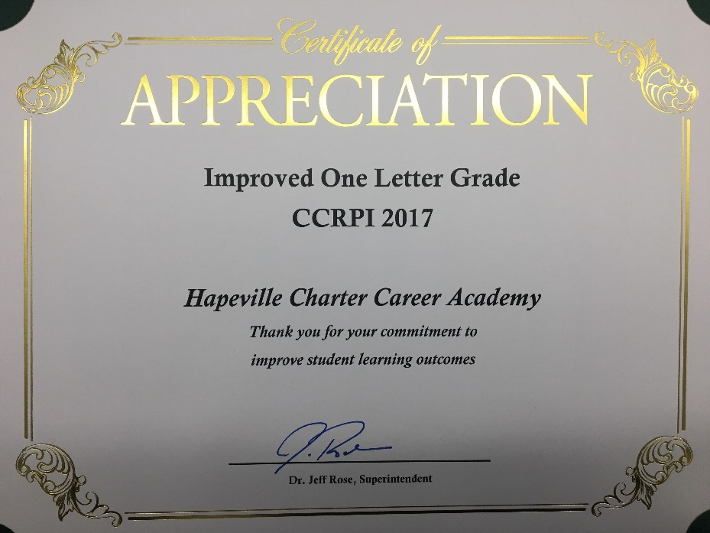
What services do we provide?
English as a Second Language
Special Education services in a collaborative setting
Teacher provided tutorial
Extended Day Tutorial and Saturday School
Summer School
Online learning applications to assist with curriculum and the Georgia Milestones
Dual Enrollment
Work-Based Learning
Virtual Lab for Remediation and Acceleration

Slide 16
Communication
Website
Twitter
Remind
School Messenger
Edmodo
Google Classroom
Newsletters
Home Access Center
Parent Conferences and Parent Conference Evenings

Slide 17
Climate and Culture Expectations
Care
Cooperation
Dedication
Goal Orientated
Honesty
Independent Thinking
Respect
Responsibility
Safety
Self-directed learning
Self-discipline
Self-Motivation
Implementation of PBIS Positive Behavioral Intervention and Supports
Discipline is enforced according to the Fulton County Schools Code of Conduct.
http://bit.ly/HCSstudent

Slide 18
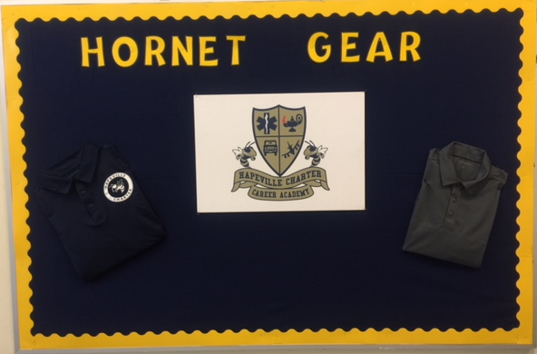
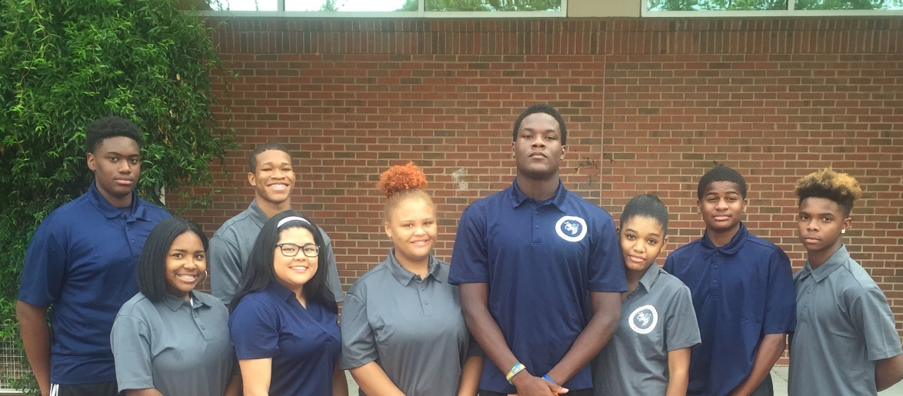
Uniforms
Uniforms are mandatory
HCCA gray polo shirt
HCCA blue polo shirt
Khaki pants (tan)
Solid black or brown shoes
Solid Black or Brown belt

Slide 19
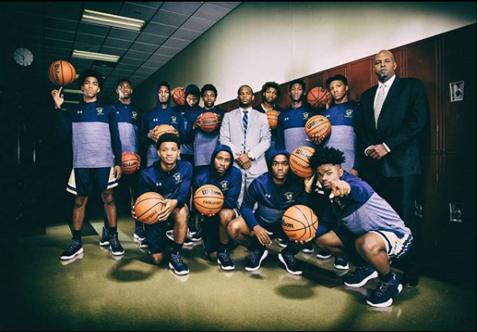
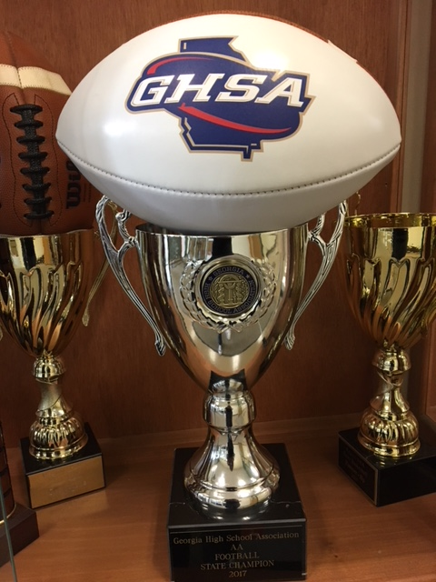
Extracurricular Activities
Anime Club
Baseball
Basketball
Cheerleading
Football
Future Business Leaders of America and Skills USA
National Beta Club
National Honors Society
Student Government Association

Slide 20
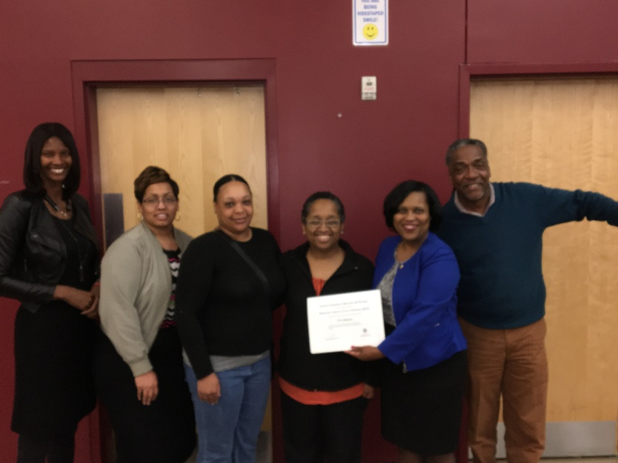
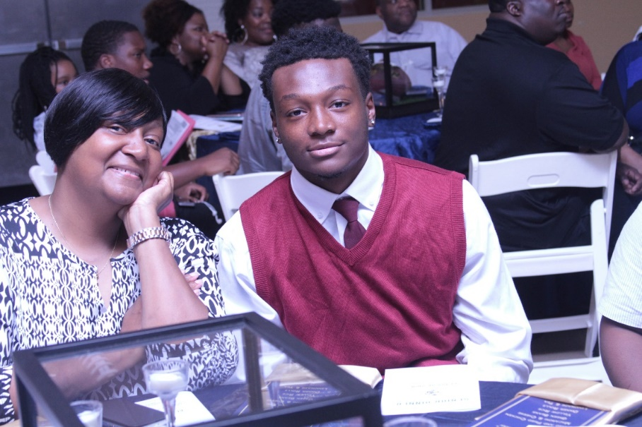
Parent Expectations
Check the progress of students daily
Communicate with teachers
Assist students with securing volunteer hours
Support the established rules and code of conduct
Be a member of our Parent Teacher Student Association
Make sure students attend daily and on time
Participate in school initiatives and fundraisers
Attend school activities

Slide 21
18/19 Planning
647 students
Master Schedule
One teacher not returning
One teacher requested not to return
Meetings with faculty and staff in April 2018
Recreating partnership Atlanta Technical University
Budget
Title I Funds - $233,682.00
Professional Learning – literacy and standards-based classroom framework
9 | 10 | 11 | 12 | SEC
178 | 178 | 168 | 122 | 1

Slide 22
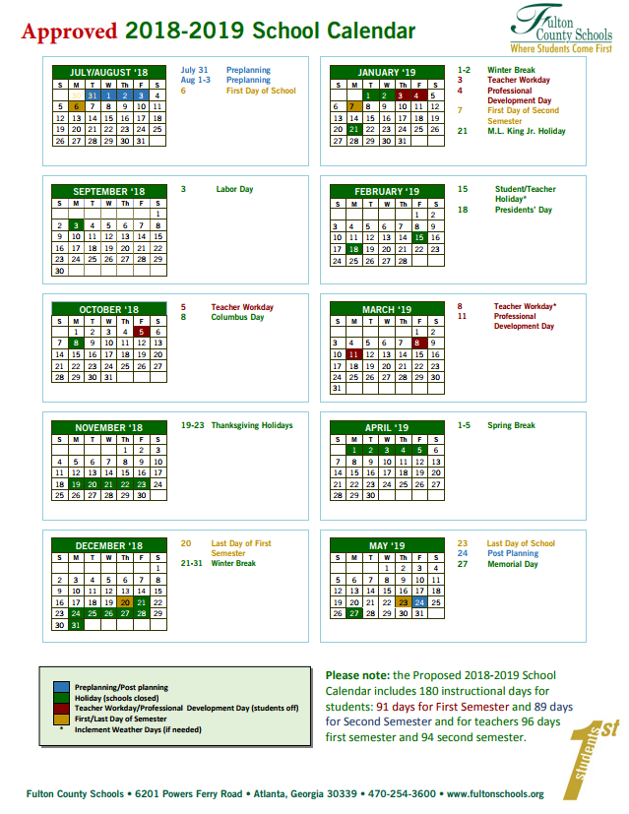
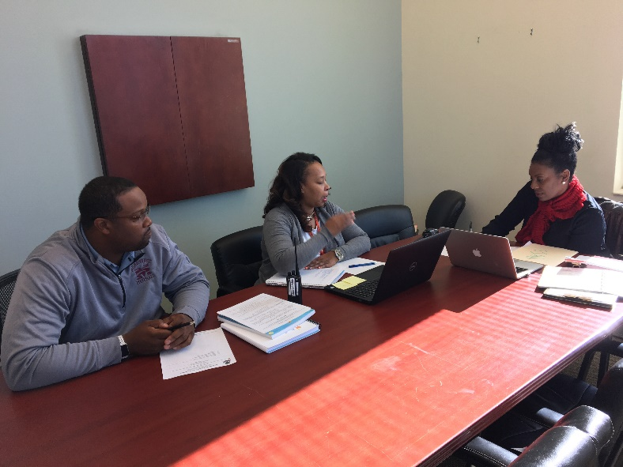
School Year
School Calendar follows the Fulton County Schools calendar found at www.fultonschools.org
Four additional Full Release Days for Professional Learning

Slide 23
Class of 2018
Agnes Scott College | Concordia College | Reinhardt University
Alabama A&M University | Coppin State University | Savannah State University
Alabama State University | Emory University | Southern University
Albany State University | Fort Valley State University | Stanford University
Allen University | George Mason University | Tennessee State University
Army West Point | Georgia Military College | Tuskegee University
Atlanta Technical College | Georgia State University | University of Pennsylvania
Barnard College | Howard University | University of Alabama
Barry University | Hutchinson College | University of Georgia
Benedict College | Lagrange College | University of Nevada Las Vegas
Bennett College | Livingstone College | University of South Carolina
Brandeis University | Miles College | University of West Georgia
Brenau University | Minnesota West College | Valdosta State University
Catawba University | Norfolk State University | Virginia State University
Charles R. Drew University of Medicine | Ohio State University | Wellesley College
Clark Atlanta University | Paine College | Wesleyan College
Clayton State University | Philander Smith College | Westminster College

Slide 24
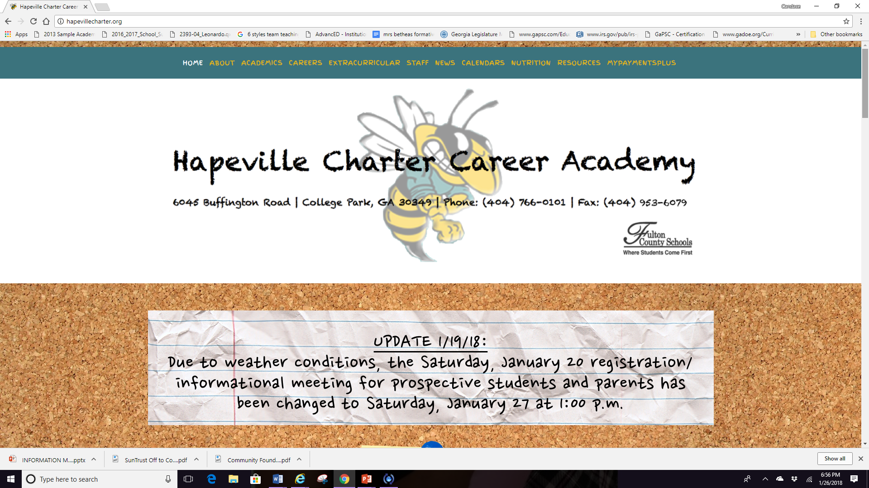
Follow us on Twitter and visit our website
@TheHCCAHornets
www.hapevillecharter.org

Slide 25
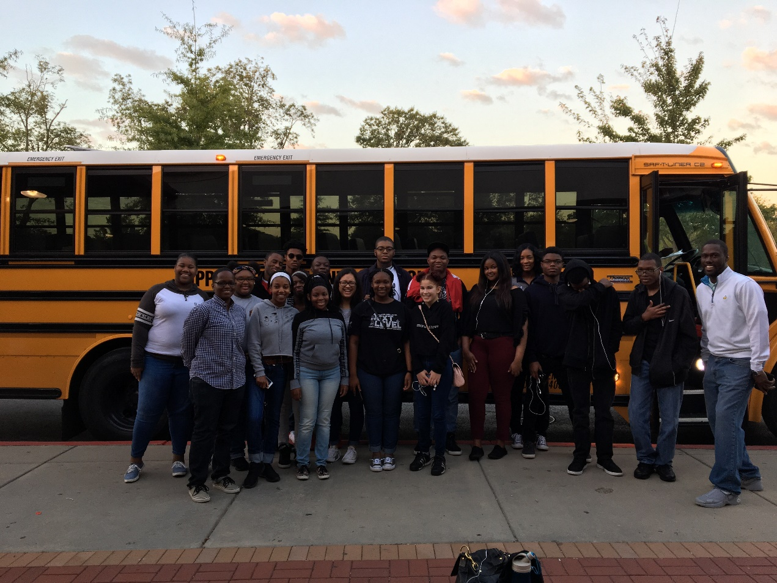
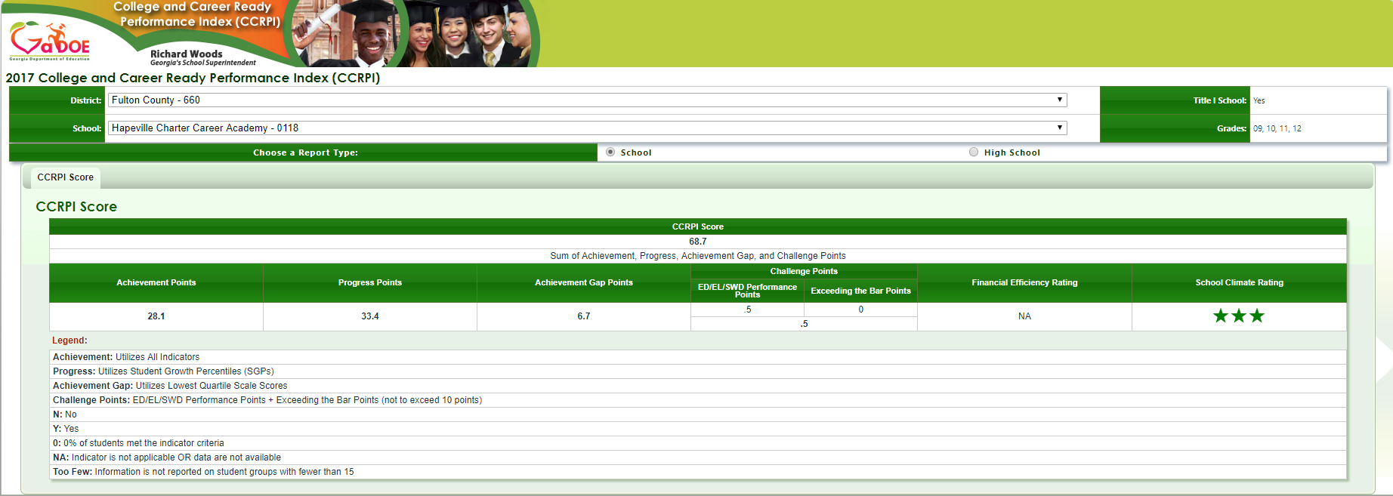
Questions

