Slide 1
State of the School Hapeville Charter Middle School
Welcome to our school’s
annual state of the school address.
Please sign in and grab informational handouts.
Prepared by Ms. Marcia Strong, Principal
Ms. Stacy Henry, Asst. Principal
Mr. Darrie Nowell Associate principal
Mrs. Jerilyn Robinson, Curriculum AP
Ms. Anella Young, Parent Liaison
Ms. Jentrell Stembridge Literacy Coach
Dr.Evans, Data Support Specialist

Slide 2
OUR MISSION
“The mission of Hapeville Charter Middle School is to prepare each student, within a safe and caring learning environment, for successful transition to high school

Slide 3
What is Title I?
Title I, Part A of the Elementary and Secondary Education Act (ESEA) provides financial assistance to states and school districts to meet the needs of educationally at-risk students. The goal of Title I is to provide extra instructional services and activities which support students identified as failing or most at risk of failing the state’s challenging performance standards in mathematics, reading, and writing.

Slide 4
How Does HCMS Participate in the Title 1 program?
HCMS provides the following services through title 1 funding :
Title I
$199,000
Extended tutorials
Student supplies
Technology equipment
Teacher professional development
Parent development classes
Parent resources
Highly qualified teachers

Slide 5
What is the College and Career Ready Performance Index?
The College and Career Ready Performance Index – CCRPI – is Georgia’s annual tool for measuring how well its schools, districts, and the state itself are preparing students for the next educational level. It provides a comprehensive roadmap to help educators, parents, and community members promote and improve college and career readiness for all students.
HCMS CCRPI 2016 57%
Our school was identified as a Focus School, which means that the GADOE calculated the three-year average of all Title I schools' (CCRPI) Achievement Gap scores. The schools were then ranked, and the lowest 10 percent were identified as Focus Schools.

Slide 6
HCMS CCRPI 2017 68%

Slide 7
What does this really mean?
The CCRPI is a complicated measurement system, but the bottom line is that because our school has exhibited at least a 2.5 point increase - 5.4 points, to be exact - in its 3-year average of Achievement Gap scores

Slide 8
December 2017 we received the exciting news that HCMS was removed from the Georgia Department of Education's (GADOE) Priority and Focus Schools list.
This means that our efforts to raise student achievement are paying off and we are very proud of our parents, students and staff for their hard work.
Although we are pleased with our progress, this is just the beginning. We will continue this forward momentum of achievement and maintain our attention on achieving at even greater levels.

Slide 9
2017 Georgia Milestones Achievement - Content Mastery = 20 Pts Developing = Points Beginning = No Points
Middle School Indicators | Benchmark for Indicator (%) | Performance on Indicator (%) | Beginner Level
Weighted percent of students scoring at Developing Learner or above on the Georgia Milestones English Language Arts EOG (required participation rate >= 95%) | 100 | 48.186 | -51.814
Weighted percent of students scoring at Developing Learner or above on the Georgia Milestones mathematics EOG or EOC (required participation rate >= 95%) | 100 | 49.32 | -50.68
Weighted percent of students scoring at Developing Learner or above on the Georgia Milestones science EOG or EOC (required participation rate >= 95%) | 100 | 22.148 | -77.852
Weighted percent of students scoring at Developing Learner or above on the Georgia Milestones social studies EOG (required participation rate >= 95%) | 100 | 31.544 | -68.456
I told you the CCRPI is a complicated measurement.
HCMS students are growing!!!!!

Slide 10
Student Growth = 40 POINTS
% of FAY students with SGP meeting typical or high growth for HCMS was 80%
Remember this is a weighted percentage

Slide 11
Ga Milestones STRENGTHS AND WEAKNESSES
The Major Strengths Discovered in our program were revealed in the percent of students in grade 8 achieving a Lexile measure equal to or greater than 1050 on the Georgia Milestones ELA EOG
The Major Weaknesses Discovered in our program were revealed in our Science, Social Studies, ELL, and Special Education programs.

Slide 12
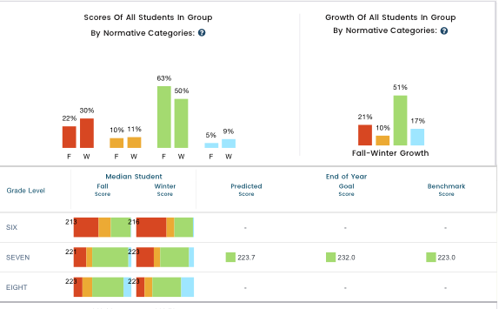
Current student growth for Mathematics

Slide 13
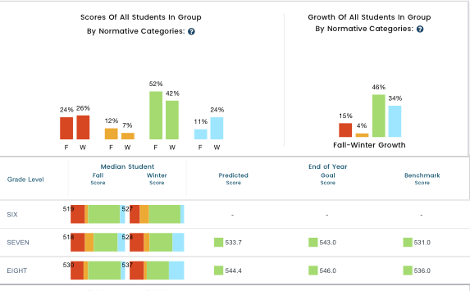
Current student growth for Reading

Slide 14
How does HCMS measure student success and growth throughout the school year?
Benchmarks (monthly in core subject areas)
FASTBRIDGE Testing
ITBS : Iowa Test of Basic Skills (8th grade only)
MYON
DART
Georgia Milestones (all grades) April 2017
Midterm & Final exams: Dec. & May
All courses use the statewide curriculum (Georgia Standards of Excellence, GSE)
ACCESS for ESOL

Slide 15
Current Benchmark Averages
ELA: 58.7% (highest growth in 8th grade, Lowest growth 7th grade)
Reading: 66.7% (highest growth 7th grade, lowest growth 8th grade)
Mathematics: 59% (highest growth in 7th grade, Lowest growth 6th grade)
Science: 53% (highest growth 8th grade, lowest 6th grade)
Social Studies: 58% (highest 8th grade, lowest 6th grade)

Slide 16
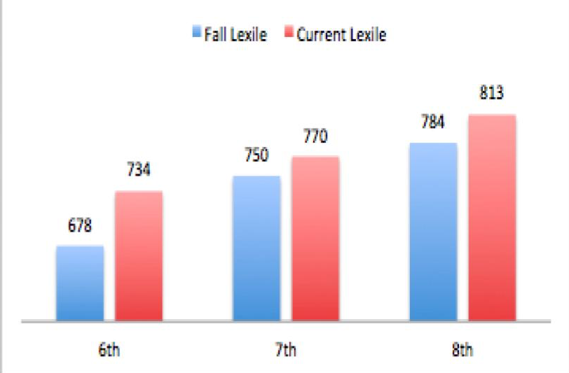
LEXILE MONITORING

Slide 17
What Can I do as a Parent to help my student?
Monitor student grades regularly with parent access
Encourage weekly study sessions
Partner with your child’s teacher in his/her academic progress
Use online tools to supplement the classroom instruction (study island, Myon, IXL)
Attend tutorial sessions held Saturday and during the week.
6th Grade parents, make sure students are reading and completing reading logs

Slide 18
GOALS FOR STUDENT IMPROVEMENT
SMART GOAL #1 Increase the percentage of students scoring at grade level or above on the Reading portion of Georgia Milestones from 53% to 75%.
SMART GOAL #2 Increase the percentage of students scoring at developing or higher on the Mathematics GA milestones from 39% to 65%.
SMART GOAL #3 Increase the percentage of students scoring at grade level or above in writing from 41% to 65%

Slide 19
HOW WILL WE MEET OUR GOAL
INCREASE DIFFERENTIATED INSTRUCTION IN ALL CLASSES WITH REGULAR TEACHER FEEDBACK FROM ADMINISTRATION
INCORPORATE MORE TECHNOLOGY USAGE OF ACADEMIC PROGRAMS WHICH CAN BE USED AT SCHOOL AND HOME
OFFER EXTENDED LEARNING TUTORIALS ON SATURDAYS AND AFTER SCHOOL
PROVIDE ACADEMIC COUNSELING FOR PARENTS MONTHLY
INCREASE PARENTAL INVOLVEMENT

Slide 20
HCMS TITLE I STATUS
HCMS is NO LONGER A Focus school, which means we increased the academic performance of the lowest quartile of students not meeting state standards in the content areas of Math and ELA.
This status tells us that student growth is improving and is increasing at enough rate to compete with other students in the state.

